Slide 1
Jermyn Borough Council Meeting
01/17/19

Slide 2
Meeting Agenda
Call to Order
Pledge of Allegiance
Roll Call
Previous Meeting Minutes
Treasurer’s Report/Bills Payable
Correspondence
Public Comment
Reports of Committees
Grant Funding/Revenue Anticipation Note
Business Permit Ordinance
Rushbrook Creek Project Grant
Follow up on Carol Morcom Dedication of Girl Scout Corner
Follow Up on Rates for Electric
Follow Up on Woodlands Sewer Video
Follow Up on Parking Lot Paving
Bonding Issue
Rental Unit Permit Updates
NEIC Permit/Inspection Fees
New Business
Adjournment

Slide 3
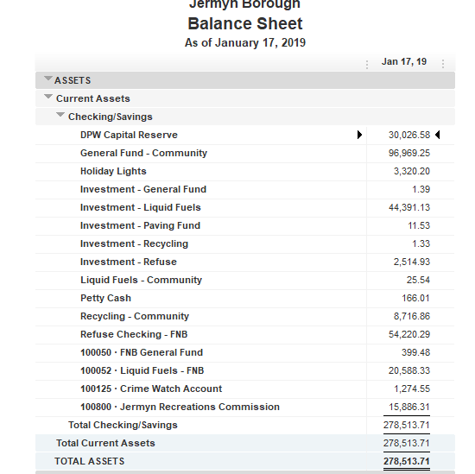
Treasurer’s Report

Slide 4
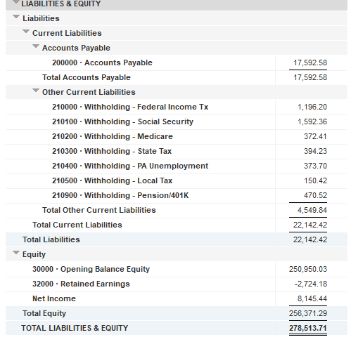
Treasurer’s Report

Slide 5


Slide 10


Slide 12
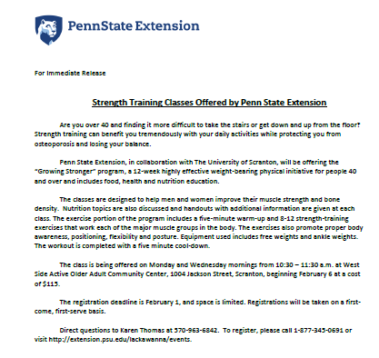

Slide 14


Slide 17


